Slide 1
AnalyzinG Amazon Sales data

Slide 2
Problem Statement:
Sales management has gained importance to meet increasing competition and the
need for improved methods of distribution to reduce cost and to increase profits. Sales
management today is the most important function in a commercial and business enterprise.
Do ETL: Extract-Transform-Load some Amazon dataset and find for me
Sales-trend -> month-wise, year-wise, yearly_month-wise
Find key metrics and factors and show the meaningful relationships between
attributes. Do your own research and come up with your findings.

Slide 3
Research:
Analyzing sales trends on year-wise basis.
Identifying and calculating key sales metrics.
Investigating the relationships between different attributes such as product categories, Country , cost and sales regions.
Providing actionable insights based on the analysis.

Slide 4
Techniques used:
Microsoft Power BI for Useful Insights and Dashboards
Microsoft Power BI help to transform raw sales data into actionable insights and interactive dashboards.
Power BI's robust features and capabilities will enable businesses to optimize sales performance, reduce costs, and increase profitability through data-driven decision-making.

Slide 5
Methodology:
Data Collection: Gather sales data that includes the sales amount, date of sale, product details, customer demographics, sales region, and other relevant attributes.
Data Preprocessing: Clean the data to handle missing values and remove duplicates. Convert date columns to appropriate formats and create new columns for month and year from the date of sale.

Slide 6
Data Analysis: Sales Trend Analysis:
  Year-wise trend: Aggregate sales by each year.
Key Metrics Calculation:
  Total Sales
  Total Profit
  Order Date and Ship Date
  Sales by Product
  Sales by Region

Slide 7
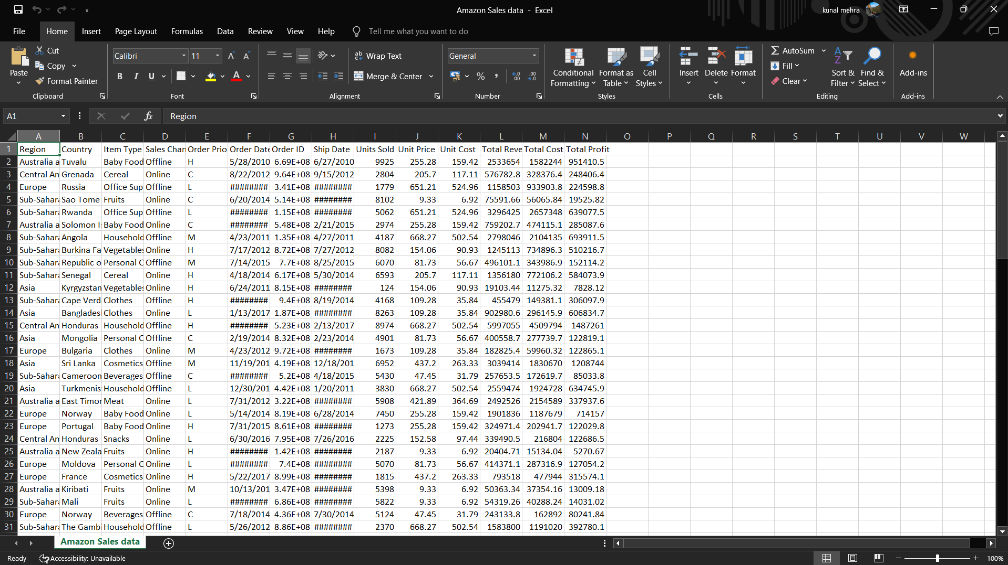
Excel file : Amazon Sales data

Slide 8
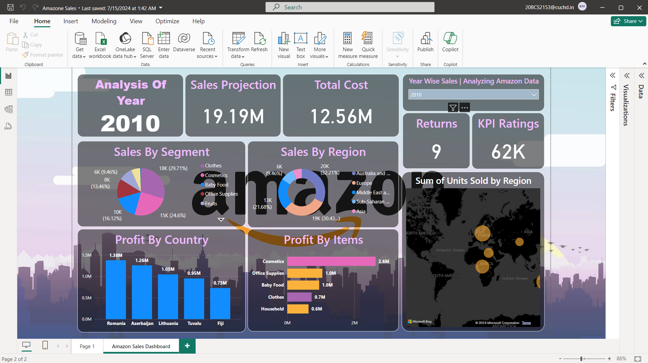
Power BI Dashboard

